Slide 1
Policy and Strategy for environmental health promotion in Nepal
Dr. Dipendra Raman Singh
Chief, Quality Assurance and Regulation Division, MOHP

Slide 2
Policy and Strategy for environmental health promotion in Nepal
Environmental protection, public health and human rights
Environmental health as an emerging issue globally
Context of Environmental health in Nepal
Policies and Strategies related to Environmental Health

Slide 3
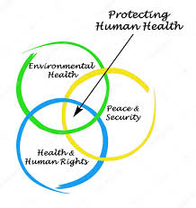
Environmental Health, Public Health and Human Rights
Environmental protection, public health and human rights have traditionally been viewed as separate and distinct areas of public policy
Currently to protect human health, there is clear link between environmental and public health issues with issues related to human rights related to peace and security
12/11/2019

Slide 4
Environmental protection, public health and human rights..
Internationally, the right of humans to health as originally enunciated in Article 25 of the Universal Declaration of Human Rights is quite clearly linked to
environmental protection, where clean water, clean air, adequate shelter and food, and
primary health care are no longer considered societal privileges but as universal human rights.
12/11/2019

Slide 5
Environmental Health and Human Rights
In addition, the link between environmental and public health issues with issues related to basic human rights are more recognised with
increasing globalisation,
the environmental and public health impacts of rapid industrialization and
urbanisation throughout different regions of the world are now being recognised as having major human rights implications by many policy makers.
12/11/2019

Slide 6
Environmental health as an emerging issue globally
Environmental health addresses all human-health-related aspects of the natural environment and the built environment.
Environmental health is one of the areas with widest scope ranging from general sanitation to
countering the effects of global warming,
electromagnetic fields and
degradation of ozone layer, to name a few.

Slide 7
Environmental health as an emerging issue globally ..
World Health Organisation;Mortality and burden of disease from unhealthy environments: (in 2012)
23% of all deaths (12.6 m) due to living/working in an unhealthy environment,.
The fraction of the global burden of disease due to the environment is 22%.
Up to 26% of all deaths could be prevented in children under five years,, if environmental risks were removed.
Air pollution alone (including ambient and household exposures) was responsible for approximately 7 million early deaths with Low and Middle-Income countries having the greatest burden.

Slide 8
Context of Environmental health in Nepal
Nepal is one of the fastest urbanizing countries, urban population growth rate of 3.7% in 2018 (The World Bank).
Nearly 50% of Nepal’s population lives in urban areas facing the unprecedented challenges of environmental problems.
With a population of approximately 3 to 4 million people, the Kathmandu Valley is the hub of Nepal’s urbanization, home of 24% of the country’s urban population (Ministry of Urban Development, 2015).
Indoor and outdoor air pollution, waste management issues, healthcare waste management issues and water pollution cause a significant strain to the environment of Nepal.

Slide 9
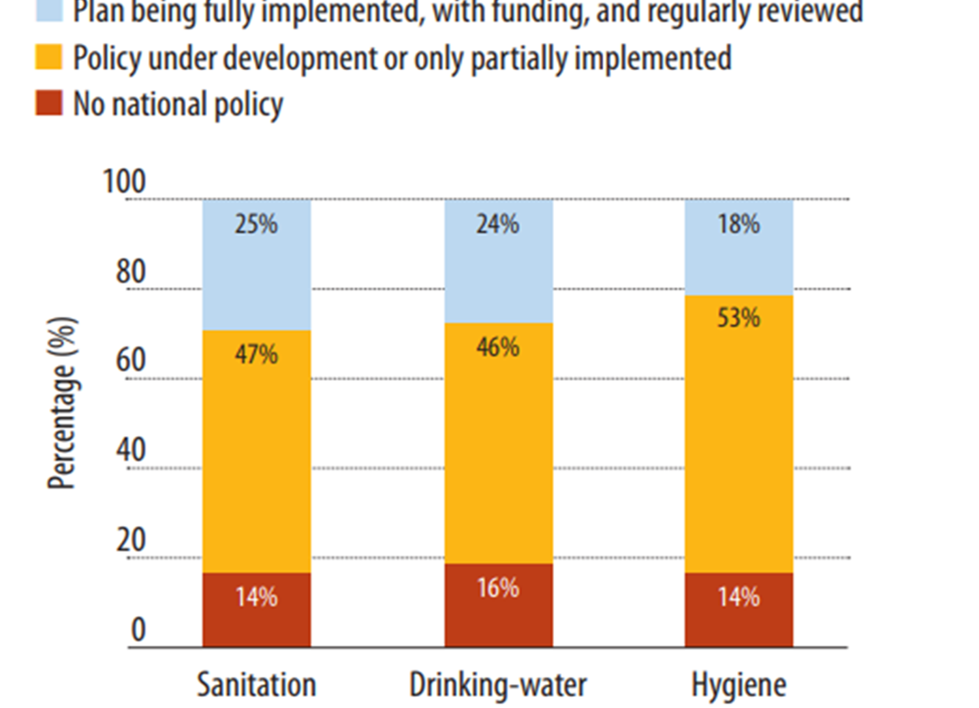
Status of national policies and plans on WASH in health care facilities
The UN-Water Global Analysis and Assessment of Sanitation and Drinking-water (GLAAS) report 2014, showed that in the 88 countries which responded to the question, only a quarter had a plan for sanitation in health care facilities that is implemented with funding and regular review. The proportion of countries with plans for drinking-water and hygiene are even less
12/11/2019
Legal framework on HCWM - Indu Bikram Joshi

Slide 10
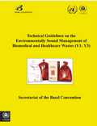
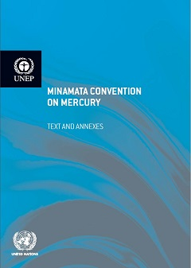
International Conventions
Basel Convention (1989)
Controls transboundary movements of hazardous waste including medical and pharmaceutical waste
Stockholm Convention (2001)
A global treaty to protect human health and the environment from persistent organic pollutants (POPs)
Minamata Convention (2013)
calls for the phase-out of mercury thermometers and sphygmomanometers used in health care
UN Human Rights Council
Incineration should be avoided
Notes:
Stockholm: 180 member countries, Countries have to take measures to further reduce releases of dioxins and furans “with the goal of their continuing minimization and, where feasible, ultimate elimination.”
Source with “the potential for comparatively high formation and release” of dioxins & furans: Medical Waste Incinerator
“Priority consideration should be given to alternative processes, techniques or practices that have similar usefulness but which avoid the formation and release of … [dioxins and furans].”

Slide 11
Stockholm and Basel Convention
Health care waste management practices seek to implement
environmentally sound management of hazardous waste or other waste (ESM) ,
Best Environmental Practices (BEP) and
Best Available Techniques (BAT) in accordance with the Basel and Stockholm Conventions and relevant national regulations and requirements.

Slide 12
International principles
Polluter pays principle is enacted to make the party responsible for producing pollution responsible for paying for the damage done to the natural environment.
Other Principles are
Precautionary-Where there are threats of serious or irreversible damage, lack of full scientific certainty shall not be used
Duty of care- any person handling or managing hazardous substances or related equipment is ethically responsible for applying the utmost care
Proximity -treatment and disposal of hazardous waste take place as near as possible to the point of production
Prior informed consent- Requires that affected communities and other stakeholders be explained of the hazards and risks
Notes:
Stockholm: 180 member countries, Countries have to take measures to further reduce releases of dioxins and furans “with the goal of their continuing minimization and, where feasible, ultimate elimination.”
Source with “the potential for comparatively high formation and release” of dioxins & furans: Medical Waste Incinerator
“Priority consideration should be given to alternative processes, techniques or practices that have similar usefulness but which avoid the formation and release of … [dioxins and furans].”

Slide 13
Regional (SAARC Level Commitments)
The Dhaka Declaration on Waste Management (2004), under which Nepal pledged for the closure of open-dumping site and for the safe treatment of health care waste, giving priority to non-burn technology.
agree that present informal waste picking practice be improved as a safe and eco-friendly practice by improving the working conditions of the waste pickers and thereby reducing the occupational health hazard and agree to encourage NGOs and private companies to establish community based segregation at source, separate collection and resource recovery from wastes with particular focus on composting.
agree that hospital waste may be treated as a special waste and managed separately.
agree that waste collection disposal and treatment may be privatized to allow greater mobilization of capital. To attract foreign investment in waste management projects financing opportunities
12/11/2019

Slide 14
Environmental Policy in Nepal
Nepal Constitution 2015: Fundamental right regarding clean environment and right to health care
Each person shall have the right to live in a healthy and clean environment.
The victim of environmental pollution and degradation shall have the right to be compensated by the pollutant as provided for by law.
Each citizen shall have the right to access to clean water and hygiene.
Solid waste management act 2011: Provision of punishment if one throws, keeps, discharge or cause to discharge chemical waste, industrial waste, medical waste or hazardous waste haphazardly;
The Environmental Protection Act 1997 : provisions for Initial Environmental Examination (IEE) and Environmental Impact Assessment (EIA)
12/11/2019

Slide 15
Nepal Constitution
३०. स्वच्छ वातावरणको हकः
(१) प्रत्येक नागरिकलाई स्वच्छ र स्वस्थ वातावरणमा बाँच्न पाउने हक हुनेछ । (२) वातावरणीय प्रदूषण वा ह्रासबाट हुने क्षतिबापत पीडितलाई प्रदूषकबाट कानून बमोजिम क्षतिपूर्ति पाउने हक हुुनेछ । (३) राष्ट्रको विकास सम्बन्धी कार्यमा वातावरण र विकासबीच समुचित सन्तुलनका लागि आवश्यक कानूनी व्यवस्था गर्न यस धाराले बाधा पुर्‍याएको मानिने छैन ।
३५. स्वास्थ्य सम्बन्धी हकः
(१) प्रत्येक नागरिकलाई राज्यबाट आधारभूत स्वास्थ्य सेवा निःशुल्क प्राप्त गर्ने हक हुनेछ र कसैलाई पनि आकस्मिक स्वास्थ्य सेवाबाट वञ्चित गरिने छैन । (२) प्रत्येक व्यक्तिलाई आफ्नो स्वास्थ्य उपचारको सम्बन्धमा जानकारी पाउने हक हुनेछ । (३) प्रत्येक नागरिकलाई स्वास्थ्य सेवामा समान पहुँचको हक हुनेछ । (४) प्रत्येक नागरिकलाई स्वच्छ खानेपानी तथा सरसफाइमा पहुँचको हक हुनेछ ।

Slide 16
Solid Waste Management Act, 2011 (related to SWM)
४१. सरसफाई तथा फोहोरमैला व्यवस्थापन : (१) वातावरणीय प्रदुषण तथा फोहोरमैलाबाट मानव स्वास्थ्यमा पारेको वा पार्ने प्रतिकूल प्रभावलाई नियन्त्रण गर्नको लागि नेपाल सरकारले प्रचलित सङ्घीय कानून बमोजिम आवश्यक मापदण्ड बनाउन सक्नेछ। (२) स्वास्थ्यजन्य फोहोरमैला संकलन, पुन: प्रयोग, प्रशोधन, बिसर्जन र नियमनको लागि नेपाल सरकारले आवश्यक मापदण्ड बनाउनेछ। (३) उपदफा (१) र (२) बमोजिमको मापदण्डको पालना गर्नु प्रदेश तथा स्थानीय तहको कर्तव्य हुनेछ। (४) प्रत्येक स्वास्थ्य संस्थाले तोकिएको मापदण्ड बमोजिम जोखिम रहित र जोखिमयुक्त फोहोरहरूलाई छुट्याई व्यवस्थापन गर्नु पर्नेछ। (५) प्रत्येक स्वास्थ्य संस्थाले सेवा प्रदायकलाई तोकिएको मापदण्ड बमोजिमको स्वच्छ खानेपानी उपलब्ध गराउनु पर्नेछ।

Slide 17
Local Government Operation Act 2017
Land fill site for Solid waste management is mandatory to become a Municipality
To regulate, operate and monitor basic Sanitation and Health program overall power is under the local government
Urban Health Policy 2015
Delivering quality essential health services to the urban population, particularly to the urban poor, women, children, and marginalized groups through Urban Health Promotion Centers. Ministry of Health and Kathmandu Metropolitan City is on its trajectory to upgrade Urban Health Centers to Urban Health Promotion Centers. The service delivery package includes environmental health staff and activities, among which WASH and occupational health and safety will be prioritized.
12/11/2019
National guidelines and strategy - Chudamani Bhandari

Slide 18
National Health Policy, 2019
Surveillance system shall be implemented on environment, sanitation, drinking water and food items, etc. in coordination with concerned stakeholders.
Environment and health-friendly technologies shall be encouraged;
state and local levels shall be made responsible for proper management, regulation and
continuous monitoring of waste and medical garbage produced by hospitals, health institutions and laboratories.
Coordination and advocacy shall be done to promote domestic and community waste management and environment cleanliness.
Programmes to minimize climate change-induced health problems shall be revised and developed in collaboration and coordination with stakeholders.
12/11/2019
National guidelines and strategy - Chudamani Bhandari

Slide 19
The Public Health Service Act, 2075 (2018)
Noise and air pollution:
(1) The Government of Nepal may, for reducing the effect to the public health by noise, air, water and visibility pollutions, determine standards regarding this in accordance with the Federal law.
(2) It shall be the duty of the Province, Local Level, general public, entrepreneurs, businesspersons, organizations and institutions to comply with the standards.
(3) The Government of Nepal shall, for reducing the effect to the public health by sound, air, water and visibility pollutions, determine standards as to the noise, air, water, and visibility pollution in accordance with the Federal law.
12/11/2019
National guidelines and strategy - Chudamani Bhandari

Slide 20
The Public Health Service Act, 2075 (2018)
Sanitation and waste management:
(1) The Government of Nepal may, in order to control or cause to be controlled the adverse effect to the human health by environmental pollution and waste, make necessary standards in accordance with the prevailing Federal law.
(2) The Government of Nepal shall make necessary standards for collecting, reusing, refining, disposing and regulating the health friendly waste.
(3) It shall be the duty of the Provincial and Local Level to comply with the standards.
(4) Each health institution shall manage the risk-free and risky waste by separating them pursuant to the prescribed standards.
(5) Each health institution shall provide the service providers with clean drinking water pursuant to the prescribed standards.
12/11/2019
National guidelines and strategy - Chudamani Bhandari

Slide 21
Strategic priorities and way forward
The Ministry of Health has identified improving urban health as one of its priorities in the NHSS III (2015-2020). This includes both environmental health and occupational health programmes, and research to support evidence-based decision making (NHSS III outcomes 7 and 9)
Management Division, is working on the national and sub-national strategy for health care waste management at for national and sub-national levels .
The National Health Research Council, a Division of the Ministry of Health focuses on research and laws and policy design. Environmental health is one of the priorities.
Multi sectoral engagement and partnerships for improved health outcomes especially on Environmental Health and Climate Change (Nepal- WHO CCS)
Implementation of Health National Adaptation Plan (H-NAP) ; Climate Change Health Adaptation Strategies and Action Plans of Nepal (2016-2020)

Slide 22
Strategic priorities and way forward..
Follow the key steps suggested in WHA 72.7, Agenda Item 12.5, May 2019- resolution passed on “Water, sanitation and hygiene in health care facilities” in Nepal context including
comprehensive assessments
development and implementation of a road map
establishment and implementation of standards for safe water, sanitation and hygiene and infection prevention and control in all health care settings and setting targets set within health policies.
12/11/2019
Legal framework on HCWM - Indu Bikram Joshi

Slide 23
Environmental health and waste management section
संघ, प्रदेश तथा स्थानिय सरकारको कार्य जिम्मेवारी सम्बन्धमा श्री मन्त्रीपरीषदले स्वीकृत गरेको संघको कार्यबिस्तृतीकरणमा खानेपानी, खाद्य पदार्थ र हावाको गुणस्तरीयता अनुगमन तथा लेखाजोखा ढाँचा एवं गुणस्तरको मापदण्ड निर्धारण गर्ने उल्लेख भए अनुसार सो कार्य संचालन गर्न यो शाखा स्थापना गरीएको हो । यस शाखाको कार्यविवरण निम्नअनुसार छ :
वातावरणिय स्वास्थ्य सम्बन्धि नीति, निर्देशिका, मार्गदर्शन, मापदण्ड लगायतका दस्तावेजहरु निर्माण गर्न सहयोग तथा सहजीकरण गर्ने ।
खानेपानी, हावा तथा समग्र वातावरणले स्वास्थ्यमा पारेको असर सम्बन्धमा निगरानी, अध्ययन, अनुसन्धान तथा नियमनमा सहजीकरण गर्ने ।
स्वास्थ्य सेवाजन्य फोहरमैला व्यवस्थापन सम्बन्धि राष्ट्रिय कानुन, नीति, नियम, मापदण्ड, प्रोटोकल तयार गर्न स्वास्थ्य तथा जनसंख्या मन्त्रालयलाई सहयोग गर्ने ।
संघ, प्रदेश तथा स्थानीय तह अन्तरगतका स्वास्थ्य संस्थाहरुबाट निस्किने फोहोरमैलाको वैज्ञानिक ढङ्गले व्यवस्थापन गर्न सहजिकरण गर्ने ।
संघ अन्तरगतका स्वास्थ्य संस्थाहरुबाट निस्किने फोहरमैलाको वैज्ञानिक ढङ्गले व्यवस्थापन गर्न अनुगमन तथा नियमनका कार्यहरु गर्ने ।

Slide 24
THANK YOU

